Slide 1



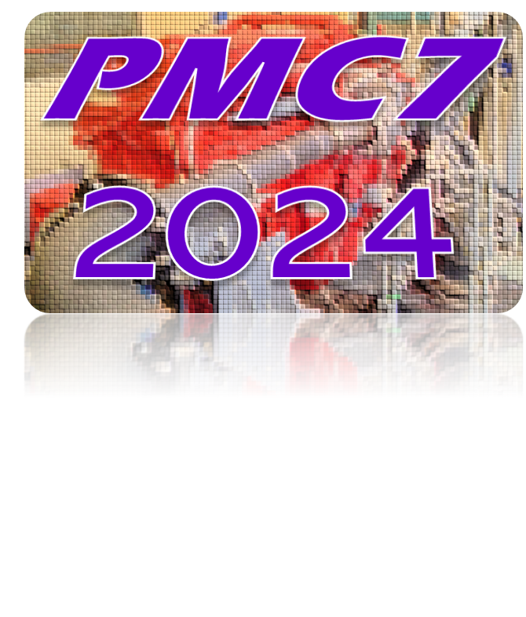



Call for Papers
30th Oct - 1st Nov 2024
Dalian University of Technology, China
7th Biennial International Conference on
Powertrain Modelling and Control
for Decarbonized, Electrified and Smart Mobility
Organization
Conference Chair
Prof. MK Ebrahimi, Loughborough U., UK
Prof. Yuhu Wu, Dalian University of Technology, China
Conference Co-Chair
Prof. Xiangyang Xu, Beihang University, China
Prof. Jian Zhao, Dalian University of Technology, China
Program Chair
Prof. Jiangyan Zhang, Dalian Minzu University, China
Prof. Amir Khajepour, U. of Waterloo, Canada
Program Co-Chair
Prof. Hongming Xu, Birmingham University, UK
Prof. Fuguo Xu, Chiba University, Japan
With the parallel event “7th IFAC Conference on Engine and Powertrain Control, Simulation and Modeling (E-COSM2024)”, the 2024 Biennial International Conference on Powertrain Modelling and Control (PMC 2024) for Decarbonized, Electrified and Smart Mobility is focusing on latest advances and developments in new generation of hydrogen, electric, and hybrid powertrains, covering dynamics, control, testing, characterization, calibration, and beyond. The format will be both in-person and online. The event will open up presentations and discussions on the solutions to challenging mobility technologies among the development of the following frontiers, but not limited to：
Organizing Committee
Organizing Committee Chair
Prof. Jinwu Gao, Jilin University, China
Prof. Sen Qiu, Dalian University of Technology, China
Prof. Xubin Song, Zhejiang U. of S&T (ZUST), China
Prof. R. G. Prucka, Clemson University, USA
Prof. Giorgio Rizzoni, Ohio State U., USA
Organizing Committee Member
Prof. Yunfeng Hu, Jilin University, China
Prof. Jingyu Zhu, Dalian University of Technology, China
Prof. Kang Song, Tianjin University, China
Prof. Liangfei Xu, Tsinghua University, China
Prof. Xiaoli Yu, Zhejiang University, China
Prof. Nong Zhang, Tongji University, China
Prof. Xiaosong Hu, Chongqing University, China
Prof. Christos Spitas, U. of Nottingham Ningbo, China Prof. Peiqing Li, Zhejiang U. of S&T (ZUST), China
Prof. Chen Lv, Nanyang Tech. U., Singapore
Dr. M. Mohammad-Pour, Loughborough U., UK
Dr. U. Montanaro, Surrey University, UK
Prof. Tornello, U. degli Studi di Catania, Italy
Prof. J. Deur, University of Zagreb, Croatia
Powertrains for Decarbonized, Electrified and Smart Mobility
Hydrogen / Synthetic Fuel
Electric Drivetrains
Hybrid Powertrains
System Identification and Control
Powertrain Optimization
Emission Legislation
Powertrain / Motor / Vehicle Testing
Safety Technology
Thermal Management
Battery Technology
Autonomous Driving Powertrain
Fuel Cell
Hardware -in-Loop Testing
Co-Simulation, FMI, FMU Integration
Performance and Drivability (NVH)
Advanced Engine Technology
Local Arrangement Committee
PMC 2024 invites full papers describing original and yet unpublished work. All papers
must include title, complete contact information for all authors, abstract, and keywords
on the cover page. Research papers reporting on new development of powertrains for
conventional, hybrid and electric vehicles, while industry and development papers reporting on actual developments of technology, products, systems and solutions. In addition, PMC (https://pmc-conference.com) will invite keynotes, organize workshop and panels. Best papers will be selected for award. All the registration shall go to PMC2024@dlut.edu.cn or pmc@lboro.ac.uk with further inquiry contact: +86-15942604160 (Ms. Zhao). This registration is also valid for the parallel E-COSM2024 (https://ecosm2024.dlut.edu.cn/).
Prof. Xian Du, Dalian University of Technology, China
Prof. Jingyu Zhu, Dalian University of Technology, China
Prof. Yongfeng Gao, Dalian University of Technology, China
Mr. Jiannan Li, Dalian University of Technology, China
Scientific Advisory Committee
Advisory Committee Chair
Prof. Tielong Shen, Sophia University, Japan
Prof. Hong Chen, Tongji University, China
Prof. Hui Xie, Tianjin University, China
Prof. Peter Tenberge, Ruhr-U. Bochum, Germany
Prof. Karsten Stahl, TU Munich, Germany
Prof. Zoran Filipi, Clemson University, USA
Advisory Committee Member
Prof. Tiancai Ma, Tongji University, China
Prof. Daofei Li, Zhejiang University, China
Prof. Dong Guo, Chongqing U. of Tech., China
Prof. Shuhan Wang, Beihang University, China
Prof. Likang Yang, Zhejiang U. of S&T (ZUST), China
Dr. Andrew Watson, Loughborough University, UK
Prof. M. Shahbakhti, University of Alberta, Canada
Prof. F. Kücükay, TU Braunschweig, Germany
Prof. Gianfranco Rizzo, U. of Salerno, Italy
Prof. Per Tunestål, Lund University, Sweden
Prof. Aldo Sorniotti, University of Surrey, UK
Prof. Marcis Jansons, Wayne State U., USA
Prof. Tartakovsky, Technion-Israel Inst. of Tech, Israel
Prof. Timothy J. Jacobs, Texas A&M U., USA
Prof. Ali Emadi, McMaster University, Canada
Prof. Chris Brace, University of Bath, UK
Prof. Fang Luo, SUNY at Stony Brook, USA
Prof. Cacciato, U. degli Studi di Catania, Italy
Paper Submission: Papers must be submitted in PDF format. Detailed submission instructions refer to the conference website. Submit your paper as well as inquiries to the meeting email: PMC2024@dlut.edu.cn. All quality papers will be recommended to IJPT for further publishing.
KEY DATES
Paper Registration
June 15, 2024
Paper Submission
August 1, 2024
Notification
September 1,2024
Final Paper
September 15, 2024
Co-organizer:
Collaborator:

